Slide 1
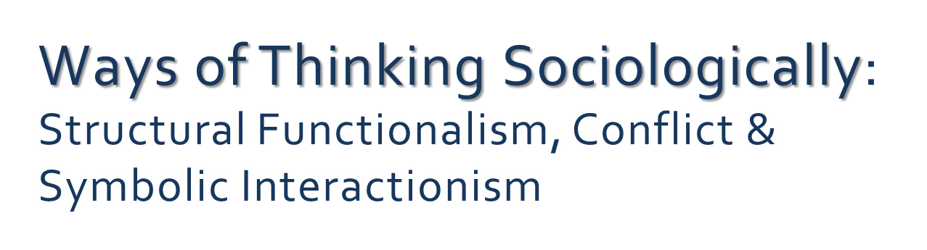


Slide 2
Overview – Part 1
Review & Extend – Structural Functionism
Conflict Paradigm
Symbolic Interactionist Paradigm
Form Base Groups

Slide 3
Learning Objectives
By the end of this class students will be able to:
Define the sociological terms used in class.
Describe three sociological perspectives (structural functionist, conflict and symbolic interactionist)
Give examples of how health and illness behaviour and the social structures of society are viewed from three sociological perspectives.
Identify the models of health (biomedical, behavioural or socioenvironmental) implicit in case examples.

Slide 4
Sociological Perspective or Paradigm
What is a sociological perspective or paradigm?
“A theoretical paradigm is a conceptual framework or school of thought in which interrelated ideas and concepts about an aspect of reality are formulated.” (Segall & Fries, p. 29)
Sociological theories & guiding assumptions
A framework for understanding human behaviour within the context of society
A framework to guide research

Slide 5
i>Clicker Review Question (Segall & Fries, Chapter 2)
Question 1: From the structural functionalist perspective, health and illness are viewed as:
professional constructs
social roles
interpersonal meanings
gendered experiences
embodied cultural facts

Slide 6




Structural Functionalism
Roles are the behaviour patterns attached to an specific institution.
Institutions are a kind of social structure that organizes the behaviour of large groups of people into standardized patterns (e.g., family, school, economic, political and health care systems).
Segall & Fries, 2011, p. 29)
Notes:
Social structures are relatively stable patterns of social behaviour learned through our society’s culture.
Society is viewed as a complex and harmonious social system that works together to promote order, stability and solidarity.

Slide 7
Structural-Functionalism – Medicalized View
Example 1: Parson’s Sick Role (1951, cited in Segall & Fries, 2011)
The Sick Role
The Sick Role Illness Behaviours
Rights Duties
Exempt from responsibility for Expected to view the condition
the condition as undesirable
Exempt from performing Expected to seek technically
well roles and tasks competent help and cooperate
Notes:
Parsons’ (1951, cited in Maio, 2010) sick role describes the social process by which society legitimates illness. This involves the sick person entering the medical system and filling the sick role. If the sick person’s behaviour does not conform to the sick role – e.g., they don’t try to get well, or they don’t follow doctor’s instructions, or their health deteriorates further because they fail to seek competent technical help…then they are considered deviant. Sickness is defined within the “context of the social system” (Holton, 2008, cited in Mao, 2010, p. 31).

Slide 8
Structural-Functionalism – Non-Medicalized View (Segall 1997, cited in Segall & Fries, 2011, p33)
The Modified Sick Role
Modified Sick Role Health Behaviours
Rights Duties
Make decisions re health-related Maintain health & manage illness
Exempt from performing usual Engage in routine self-health
roles management
Make use of social support & Make use of available health care
depend on lay others Make use of available health care
resources
Notes:
Segall(1997) argues…separate the informal sick role from the formal patient role and recognize that it is …possible to enter and exit the sick role without seeking the assistance of health care professionals and becoming a patient. There is growing research evidence that the majority of everyday health problems are self-managed and are never brought to the attention of the formal health care system.

Slide 9
Structural Functionalist Paradigm
(Parsons, 1951, cited in Segall & Fries, p. 31)
Dimensions of Health:
Social
Psychological
Physical
Parson’s analysis of illness as a social role (Sickness) = the sick role
Feeling ill (Illness )
The legitimization of sickness as Disease

Slide 10
Forming Base Groups
  Get together in groups of 5-6.
  Pick up the Group Sign-up Sheet & create a group with a mix of students from different majors (see the list)
  Pick roles for the group (leader and recorder)

Slide 11
Activity in Base Groups
Structural functionist perspective:
Parsons’ (1951) Sick Role
Segall’s (1997) Modified Sick Role (see Textbook & handouts)
Discussions Questions from Your Readings
How do Parsons’ and Segall’s concept of the sick role differ?
What assumptions about health and illness and society underlie these two conceptualizations of the sick role?

Slide 12

Structural Functionalist View
(Conrad & Schneider, cited in Bourgeault, 2010)
Sickness is viewed as a form of deviance
  Deviance is a threat to meeting social role expectations
  Deviance is a threat to society/social order
Physician Role - Social Control:
  Diagnosis (Verification)
  Legitimatize the sick role (Doctor’s note)
  Medical treatment and expectations (Defining appropriate care & Patient Compliance with medical care )
= Differential Power

Slide 13
Critique of the Sick Role
(Segall, 1977, cited in Segall & Fries 2011, p. 32-33)
What about chronic disease or disability?
The Sick Role better describes short-term acute illness behaviour.
What about psychosocial conditions?
The Sick Role describes the process of legitimizing physical illness within society.
What about self-care behaviour?
Self-care behaviours are the decisions and actions of individuals to maintain or improve their health, and to cope with a health problem.
What about social location such as culture, class , gender and age?
Decontextualized

Slide 14
Non-medicalized Sick Role
Segall (1997, 1988, cited in Segall & Fries, p 34)
Segall’s (1988) survey research in Winnipeg suggested:
Support for advice from informal support networks
No significant differences in sick role expectations by ethnicity
Significant differences in sick role expectations (right to be exempt from normal well roles) by:
  Age, employment status, education and income
Notes:
Well role release was supported by younger respondents who were gainfully employed (p. 34).

Slide 15
Limitations of Structural Functionalism
  Parson’s sick role suggests a medico-centric bias and emphasized the physician’s role in legitimizing sickness and controlling deviance.
  A good deal of the variance in sick role behaviour expectations remains unexplained (Segall & Fries, 2011, p. 34).
  Structural Functionalism’s focus on social stability (or social harmony) ignores inequalities in society (Macionis et al, 2002).
Notes:
Social structures may benefit some groups within society while disadvantaging others (Merton, 1968 cited in Macionis et al, 2002).

Slide 16
Conflict Paradigm
Base Group Discussion from the readings:
Apply the conflict perspective to consider one health issue.
What is the underlying assumption about society from this perspective?
Which model of health is critiqued?

Slide 17
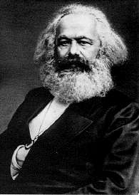
Conflict Paradigm
Karl Marx “The philosophers have only interpreted
the world, in various ways, the point, however, is to change it.” (cited in, p. 14)
Capitalist society is a complex system characterized
by social inequality and conflict over resources.
unequal access to education, money, social prestige and power.
embedded within social structures
maintains the privileges of some groups over others (Segall & Fries, 2011; Macionis et al, 2002).
Photo: http://www.historyguide.org/intellect/marx.html
(1818-1883)
Notes:
Inequalities are present in all societies.

Slide 18
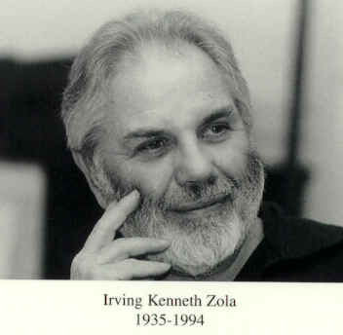
Conflict Paradigm
Irving Zola (1972)
Medicalization involves the medical control of life not just deviance.
Life has become dominated by a medicalized view of illness and social deviance.
More and more aspects of everyday life have become defined as medical matters to be controlled from the “womb to the tomb” (Segall & Chappell, 2000, p. 27)
http://www.irvingzola.com/

Slide 19
Conflict Perspective
Navarro (1976) & Waitzkin (2000, cited in Segall & Fries, p. 36)
Capitalist society makes people sick.
The medical profession treats illness as an individual problem rooted in biology and treated through health care goods and services.
Medicalizations supports the commodification of health and capitalist profits.
Notes:
Health and illenss are commoditized through the focus on health care goods and services for individual health problems.

Slide 20
Conflict Paradigm
Segall & Fries, 2011, p. 35
Health and illness are viewed as professional constructs
Medical Dominance (maintaining status and power within the health care field)
Medicalization (social control of diagnosis, access to treatment, Rx, and hospitalization).
Supports the interests of capitalists in a capitalist society.
Focus of Conflict Paradigm
Group power struggles
Social exploitation and social inequality
political and economic dimensions of health
Notes:
The Medical Profession defines disease and controls access to health care resources (the illness care system).
Power is maintained through political negotiation and public persuasion (Segall & Fried, 2011, p. 35)
Knowledge and Research methods focus on social, economic (material) and historical context
Navarro (1976, cited in Bourgeault, 2010) viewed the capitalist mode of production as a cause of disease.
Segall & Fries (2011, p35) Political Economy – an interdisciplinary field focused on political, economic and social relations within capitalist societies

Slide 21
i>Clicker Question #2
Question 2: From a conflict perspective, health and social issues of concern include:
Social conflict, social inequalities, and the medicalization of life
Medical dominance of the health care system
a and b
Social harmony, social roles and social control
Long term sickness and an inability to maintain social roles in society

Slide 22
Limitations of Conflict Theory
Sociological critique of the biomedical model of health and the illness care system presents somewhat of a caricature of the role of the medical profession within society.
The focus on power and control, social ,economic and historical context overlooks the role played by medicine in promoting primary and secondary prevention of disease and preventive health behaviour. (Segall & Fries, p. 39)
Lacks a focus on the meaning of health encounters.
Lacks a focus on Epidemiology and Social Medicine.

Slide 23

Conflict Theory
Example
Discussion
How might the focus on profits in a capitalist society interfere with the health of certain groups?

Slide 24
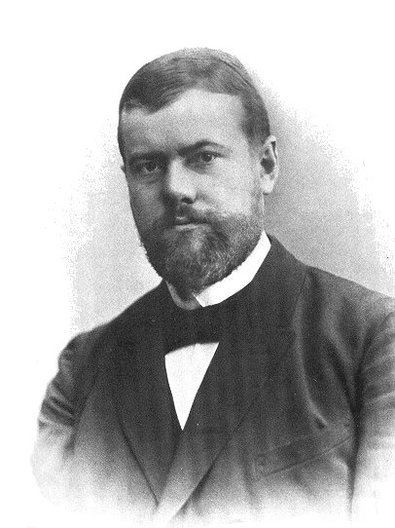
Symbolic Interaction Paradigm
Weber was interested in understanding how society and reality were constructed through social interaction.
Focus : Understanding the point of view of people in the setting
Micro-level
How is society experienced?
(Macionis et al, 2002)
(1864-1920)
http://en.wikipedia.org/wiki/Max_Weber

Slide 25


Symbolic Interactionism
Max Weber (cited in
Human interaction is meaningful.
Reality is constructed through interactions in everyday life
Understanding & Interpreting
  What people do.
  Why they do it.
= What is the meaning of health and illness to the individual?
Notes:
Social action = individual meaning
Clarke, Three assumptions:
1) “...purpose is to understand the social meanings of human social action and interaction;
2) refexivity or intersubjectivity, rather than objectivity or critical analysis, characterizes the relationship between the subject and the researcher, and
3) rich, carefully detailed description and aanlaysis fo unique social situations from the perspective of subjects…(p. 16)
Blumer (1969, cited in Patton, 2002).
Blumer was also one fo the first to use group discussion and interview methods with key informants. He considered a carefully selected group of naturally acute observers and well-informed people to be a real “panel of experts” about a setting or situation..who would take the researcher inside the phenomenon of interest, for example drug use.” p. 112

Slide 26

The Social Construction of Health
Baldovino (1962, cited in Macionis, et al , 2002. p. 83).
“Inevitably we construct ourselves. Let me explain. I enter…and immediately I become what I have to become, what I can become: I construct myself.
That is, I present myself to you in a form suitable to the relationship I wish to achieve with you. And, of course, you do the same with me…”
Health and health care are the products of social relationships (Cobur & Eakin, 1998, cited in Bourgeault, 2010, p. 56).

Slide 27
Discussion Question
How could interactions (with family, friends, and the formal health care system) influence people’s patterns of behaviour and shape the meaning of their experience of illness?
Examples from your experiences?
Are there differences between private stories about health (what you would tell a friend) and public accounts (what you would tell a doctor)? If so why?

Slide 28
Symbolic Interactionist
Examples
Disease is a Label (Labelling Theory)
  “The proposition that what people are called has major consequences for social interaction” (Patton, 2002, p. 112)
Single Mother
  “It’s like…if I went and asked for help, when we are all sick or something…well they are going to think I can’t do it by myself or something” (Participant cited in Yanicki, 2004).
Notes:
Litva & Eyles (1994, cited in Segall & Chappell, p. 29)
- explored the meaning of “good health”
- the meaning of healthiness is negotiated
“in carrying out research, the answers you receive depnd essentially on how you defined key concepts and what questions you ask”
People had difficulty defining health
Healthiness = the negotiated personal meaning of health (Litva & Eyles , 1994, cited in Segall & Chappell, p. 29) was closed tied to quality of life issues and was typically described in psychological terms.
Litva & Eyles suggest that while health (phsycial status) was important, healthiness (sense of psychosocial well-being) may be more crucial as a resourcefor the individual.

Slide 29
Symbolic Interactionism
Irving Goffman (1961, cited in Segall & Fries, p. 41)
Mental illness and the strict control of behaviours within the context of hospital settings
Stigma
The Social Construction of Medical Knowledge within social and cultural contexts

Slide 30
Limitations of Symbolic Interactionism
By focusing on subjective meanings and the social construction of health at the level of social interaction, this view fails to consider how power relations based on social inequalities and social structures influence health outcomes and individual experiences.

Slide 31
Exploring Sociological Perspectives
Activity in Base Groups
Discussion Questions (from Moodle):
From a sociological perspective, health is considered a social construction. What does this mean?
Why does it matter how people feel about health and illness (Symbolic Interactionist perspective)?

Slide 32
References
Bourgeault, I. L. (2010). Sociological perspectives on health and health
care. In T. Bryant, D. Raphael, M. Rioux Staying alive: Critical
perspectives on health, illness and health care. (2nd Ed., pp.41-63).
Toronto: Canadian Scholar’s Press.
De Maio (2010). Health and social theory. New York: Palgrave MacMillan.
Macionis, J. J., Mikael Jansson, S., & Benoit, C. M. (2002). Society: The
basics. (2nd Canadian Ed.). Toronto: Prentice Hall.
Yanicki, S. M. (2004). Social support and family assets in low-income, lone-
mother families participating in a home visitation program. Unpublished
master’s thesis. University of Alberta. Edmonton. Spring

